Slide 1

Interstate 69 Update Briefing
Speakers
Loyd Neal, Nueces County Judge Alliance for I-69 Texas Board Chair
Jeff Austin III, Transportation Commission Member
Judy Hawley, Chair, I-69 Advisory Committee
January 14, 2015

Slide 2
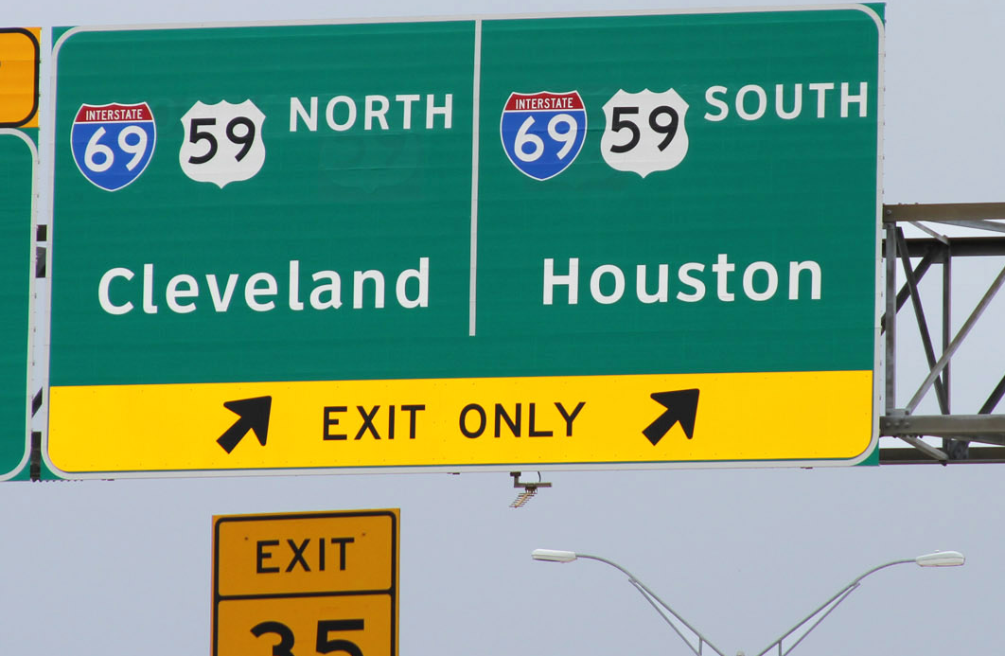

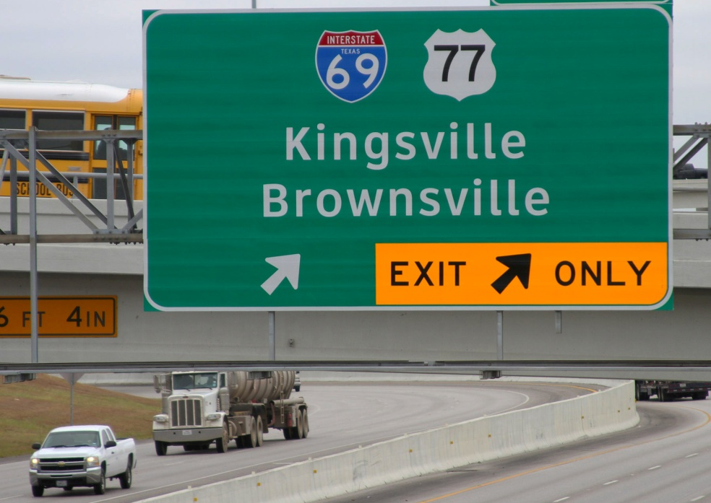
Building
Interstate 69 As A Series of
Upgrade Projects
www.i69TexasAlliance.com
January 2015
Notes:
Welcome and Introductory comments
(Ask all participants to do self introductions).

Slide 3
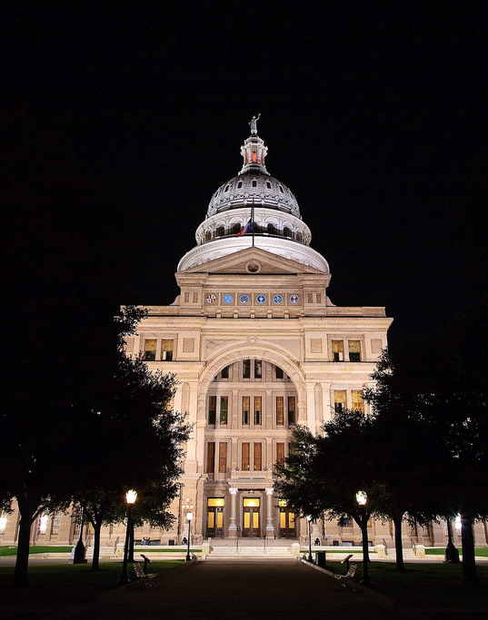
20+Years of I-69 Advocacy
The Alliance for I-69 Texas was formed in 1993 by elected officials and economic development organizations
All segments of route represented in Alliance
Have an executive director plus Washington and State Capitol representation
Persistence has helped build support from lawmakers, governor, Transportation Commission and local communities
Alliance for I-69 Texas
Notes:
Our organization -- The Alliance for I-69 Texas -- was formed in 1993 by elected officials and economic development organizations coming from far flung regions stretching from the cities that straddle the Rio Grande to the forests and oilfields near the Louisiana and Arkansas borders.
By careful design, all segments of the Texas route are represented in the Alliance
We have an executive director plus Washington and State Capitol representation, and a communications consultant – all have been with us for at least 10 years and all with years of experience in transportation and politics. We also get administrative and lobbying support from the Greater Houston Partnership.
Our unrelenting persistence has helped build support from federal and state lawmakers, the governor’s office, the Texas Transportation Commission and local communities
We have committed communities and port authorities that have been willing to stay in the fight year after year and provide financial support for the Alliance.

Slide 4
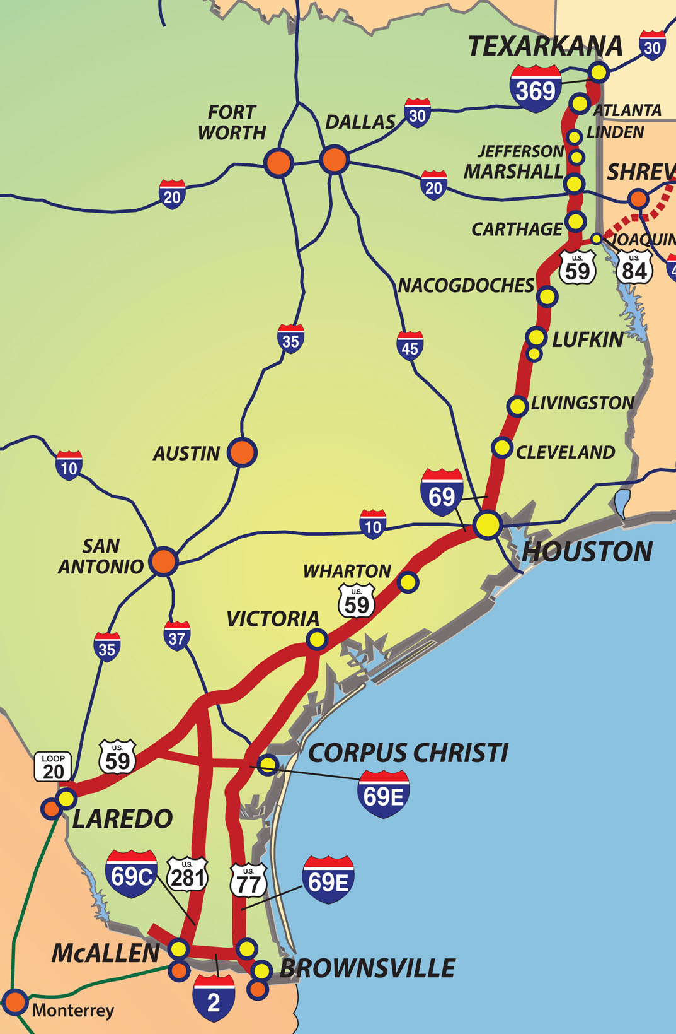
The I-69 System in Texas
1,076 miles including I-369 from Texarkana to Tenaha, I-69, plus I-69E, I-69C, I-69W, and the I-2 Connector in South Texas
One-third of Texas population lives in counties along the I-69 System Route
Houston Metro – 6.5 million
Lower Rio Grande Valley – 1.4 million
Laredo Metro - 276,000
Adjacent Mexico Cities – (2.2+ million)
Corpus Christi Metro – 559,000
Nacogdoches/Lufkin Metro – 153,000
Texarkana Metro - 144,000
Victoria Metro – 122,000
Harrison/Marion/Panola – 105,000
Connects population centers, seaports, distribution points & ports of entry
Key drivers: Freight movement, safety, connectivity & economic development
Alliance for I-69 Texas
Notes:
The I-69 system in Texas is BIG. It covers more than 1,000 miles.
One third of state population lives in counties served by I-69.
Mobility is at the heart of I-69. Communities see mobility from different perspectives – whether it is escaping the bumper to bumper traffic or providing connectivity to job markets. All communities need a way to safely and efficiently travel to jobs, schools, and markets. Furthermore, commerce needs a clear path from origin to destination.
I-69 means different things depending on the location along the route -- enhanced freight movement, connectivity, and economic development and safety of the traveling public have all been key drivers for the development of I-69.
I-69 is about investing in infrastructure because it truly is the lifeline for our communities. As the Texas economy continues to grow and thrive we are adding 30,000 vehicles each month to Texas roads. We must invest wisely to ensure our transportation system likewise increases in capacity and efficiency. Mobility provides opportunities for communities to grow, create new jobs, and improve the quality of life for its citizens.

Slide 5
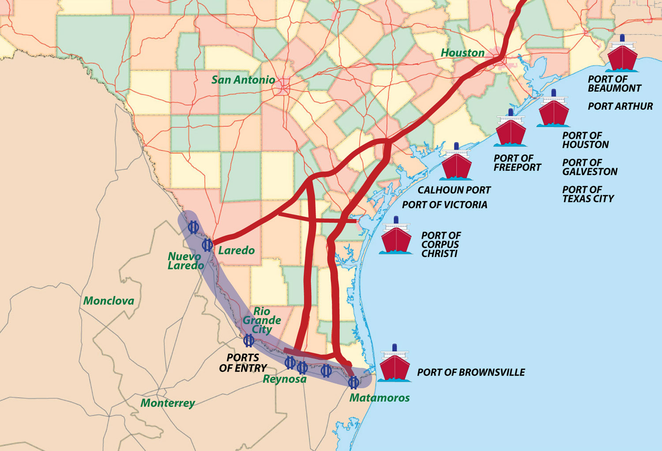
Serving Texas Ports – Land and Sea
TEXAS BORDER PORTS
50% of Total US Truck
Trade With Mexico Passes Through South Texas Ports of Entry Including Bridges in Webb, Starr, Hidalgo & Cameron Counties
TEXAS SEAPORTS
2012 U.S. Rank in
Total Tonnage
2. Houston
5. Beaumont
8. Corpus Christi
12. Texas City
23. Port Arthur
30. Freeport
Alliance for I-69 Texas
Notes:
The I-69 routes in Texas already play a vital role in freight movement and international trade, with thousands of trucks a day on these roads.
I-69 serves 200 miles of the border with Mexico – a region where the key ports of entry account for 50% of the total US truck trade with Mexico. A new industrial development in Northern Mexico and the recently completed highway connecting Reynosa to Mazatlan is expected to add to the flow of trucks through South Texas.
Container traffic through the Pacific ports at Lazaro Cardenas and Manzanillo and moving in and out of Texas is also growing
Just as important, I-69 segments serve Texas’ 10 deepwater ports which include some of the nation’s busiest seaports.
The opening of the Panama Canal expansion in 2016 will impact Texas ports over time, and in the decades ahead the I-69 route will be needed to help move goods heading to and from the ports.

Slide 6
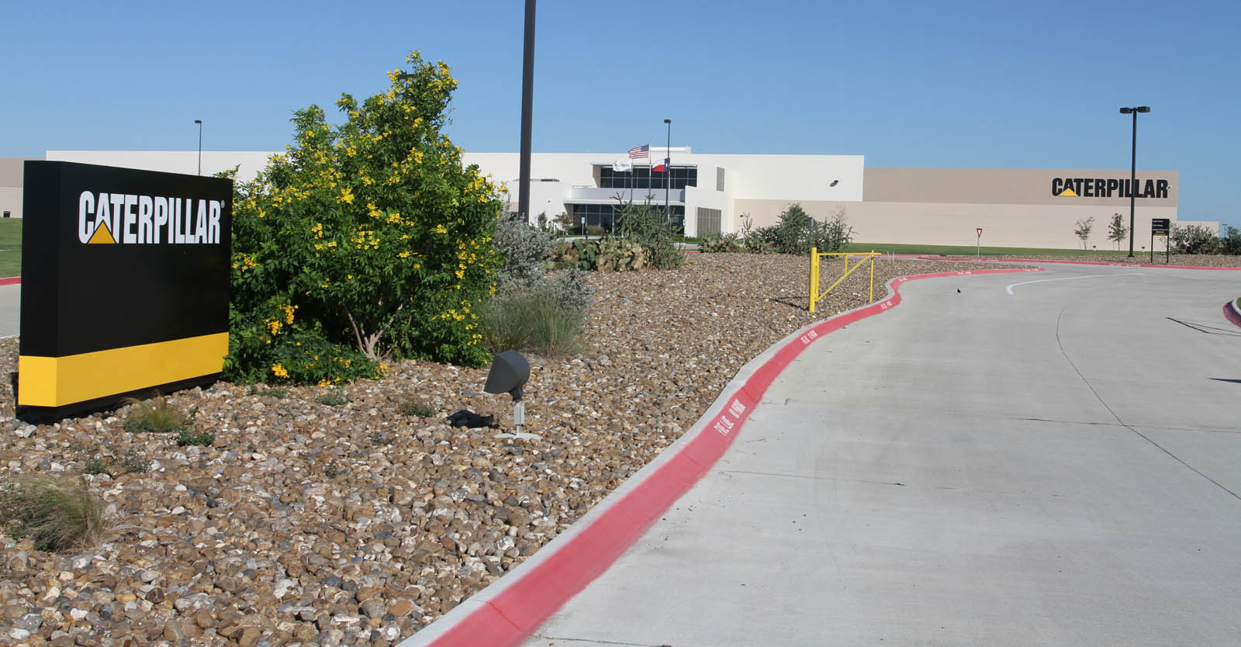
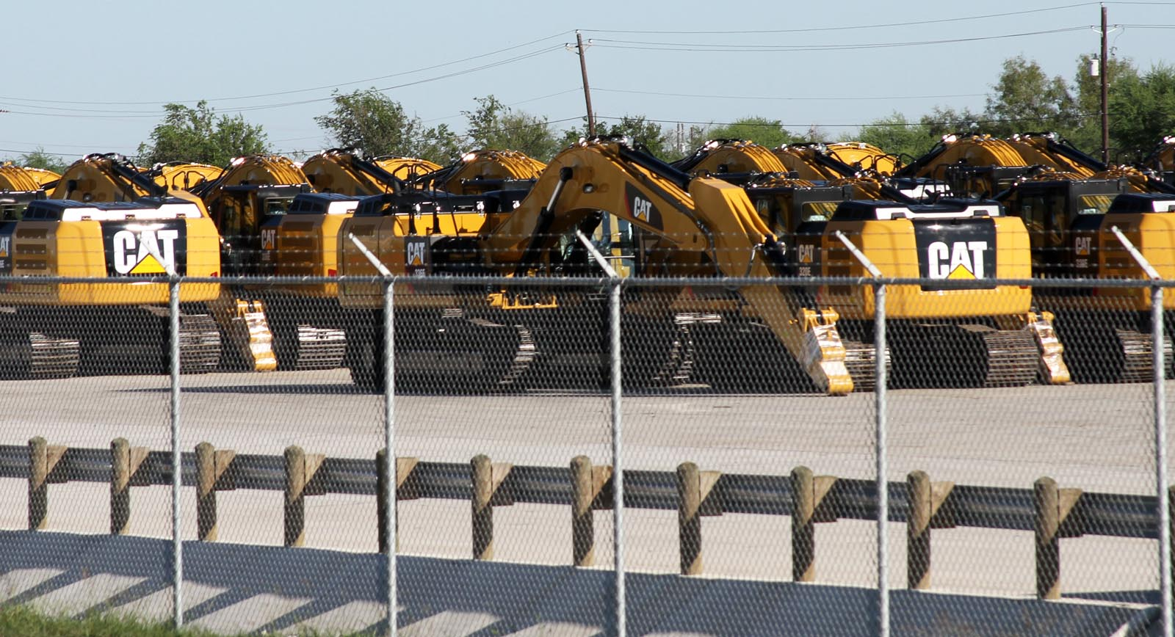
I-69 Upgrades Mean Economic Development Momentum Now
Caterpillar Plant Next to
Future I-69 in Victoria
Alliance for I-69 Texas
Notes:
Communities along the route are already seeing new site selection victories based in part on logistics tied to the prospects of I-69.
Time and time again, EDC professionals tell us that proximity to an interstate is a critical factor in site selection.
For most communities along our route, designation of I-69 will be the first interstate highway to serve their community. I-69 will be a tremendous asset for communities that have been historically under-served by the interstate highway system.

Slide 7
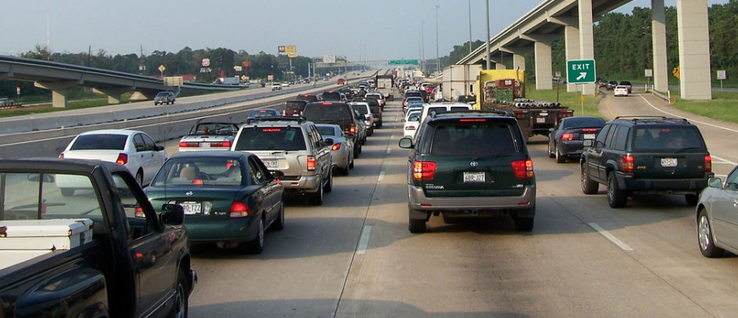
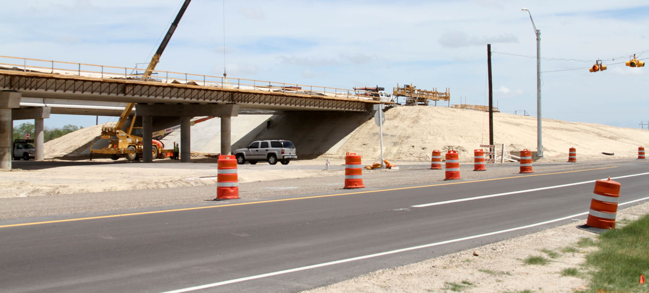
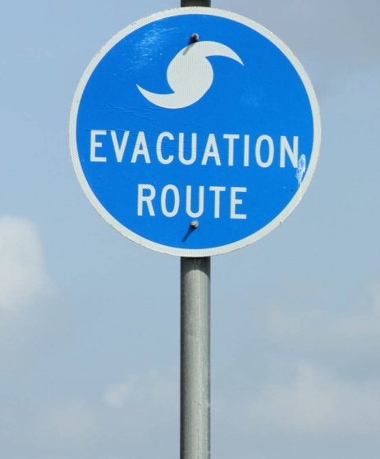
I-69 Projects Increase Safety
Hurricane Rita Evacuation on US 59 (now I-69)
US 77 Overpass Construction at Sarita (2013)
Notes:
On a macro basis, completion of I-69 sections creates improved routes for hurricane evacuation.
At the local level, completion of each I-69 upgrade project improves safety by providing grade separations, controlled access, and modern design standards.

Slide 8
I-69 Alliance Advocates
A primary role of the I-69 Alliance is to advocate for funding and legislative solutions to advance I-69
Federal level
I-69 consistently included in priority federal programs & distinctions
Funding for initial feasibility studies and project development
Legislation providing flexibility for Interstate designation
Formation of the I-69 Congressional Caucus
State & Local levels
Prop 1 placement on the ballot and approved by the voters
State legislation authorizing Transportation Reinvestment Zones, Comprehensive Development Agreements, Regional Mobility Authorities and local option vehicle registration fees
Pushed for additional route studies and moving forward on environmental clearance to get projects ready for funding
Notes:
The primary role of the I-69 Alliance is to advocate.
We seek both funding and legislative solutions to advance the project.
We have seen successes at both the federal and state levels.
There is no single solution to funding and building I-69 projects. The Alliance has supported putting a number of tools in place that can be used by TxDOT and local communities to move projects forward.

Slide 9
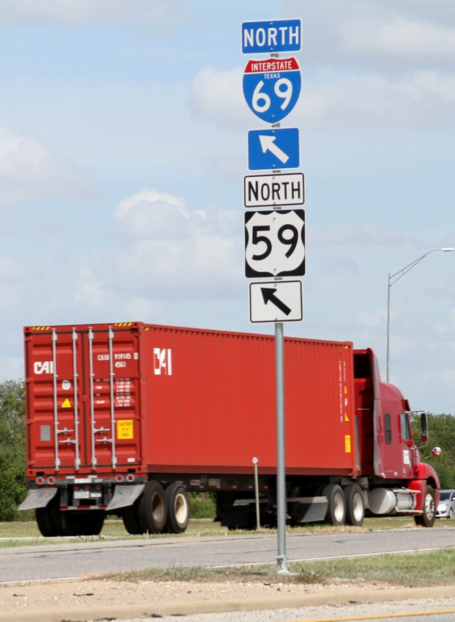
Voters Support Additional Funding
Texas is facing a major shortfall in highway funding – about $5 billion a year.
I-69 Alliance and other advocates helped win voter approval of the Prop 1 Highway Funding Amendment which captures oil and natural gas production tax revenues.
It will make about $1.7 billion available in 2015. Future revenue will depend on energy prices.
The Alliance is actively working to ensure I-69 projects are well-positioned to receive a portion of Prop 1 funding.
Alliance for I-69 Texas
Notes:
It is no surprise that Texas is facing a shortfall of about $5 B in transportation funding.
The Alliance joined with other transportation advocates during the last legislative session to help partially close this funding gap with the passage of Prop 1.
The I-69 Alliance leadership was extremely active in publicly encouraging support for Prop 1 leading up to vote in November.
As a result, we saw nearly 80% approval of the constitutional amendment – a strong statement by Texans that they recognize the need for more transportation funding. Such a resounding vote should create a growing momentum and sense of urgency when the Legislature considers the issue of transportation funding this session.

Slide 10
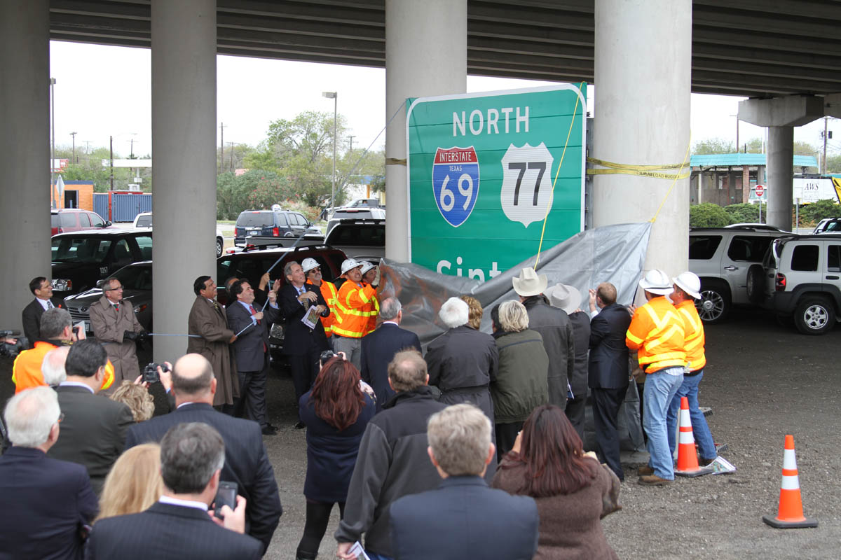
2011: First I-69 Section Signed
Alliance for I-69 Texas
CORPUS CHRISTI/ROBSTOWN
Notes:
The Alliance worked for more than 15 years before we saw the first segment of I-69 signed in Corpus Christi.
The first step was the toughest. Once we were officially on the map, we have seen numerous segments designated as I-69 stretching from Texarkana to Houston, Laredo and the Lower Rio Grande Valley.
These tangible signs of progress have further fueled the momentum and excitement for I-69.
Our mission continues to be to build a seamless Interstate 69.
We recognize that individual communities will not reap the full benefit from their local segment of I-69 until the entire route is built in Texas.

Slide 11
Partnership to Build I-69
Successful progress on I-69 is due to the strong partnership between TxDOT, the I-69 Advisory and Segment Committees and the Alliance for I-69 Texas
Each partner fills a critical role
Strong support from local, state and federal officials
Alliance for
I-69 Texas
TxDOT & Transportation Commission
I-69
Advisory &
Segment
Committees
Notes:
We like to use the 3-legged stool analogy to describe the model for success in advancing I-69.
The I-69 Alliance has worked in partnership with TxDOT and the I-69 Advisory and Segments Committees to get us to where we are today on I-69.
Each partner fills a critical and distinct role.
Alliance- advocates
Advisory and Segment Committees – provide grassroots input into project design and prioritization
TxDOT – Planning, funding and implementation professionals ensuring development of each piece of I-69
Strong support from local, state and federal officials – over the course of 20 years with considerable turn-over. Requires ongoing work to inform and empower these officials to help advance I-69.

Slide 12
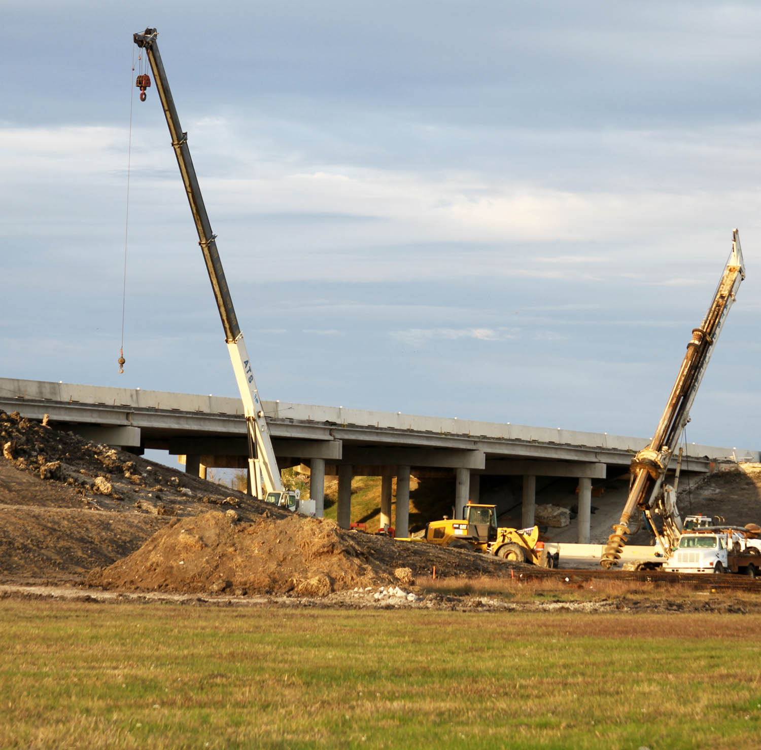
Keys to Advancing I-69
Engage locally in planning
Seek and support innovative project development strategies
Work collaboratively to complete I-69 in Texas
Help maintain I-69 as a priority with state and federal officials
US 59 Overpass Construction in Victoria (2014)
Alliance for I-69 Texas
Notes:
So what’s the key to getting I-69 built?
Success starts at the local level. Time and time again we are seeing that when local leaders unite and take the initiative in the planning and financing of I-69, things happen – good things happen and projects move forward.
Several I-69 communities – such as Harrison County and the City of Marshall as well as Lufkin and Nacogdoches, have undertaken very focused planning for localized routing of I-69. This is the first big step to getting pieces of I-69 in the pipeline for project construction.
Other communities like Laredo and El Campo are forming transportation reinvestment zones or TRZ’s as a way to generate local funding to match state funding for the development of I-69.
Several I-69 counties have established Regional Mobility Authorities that have facilitated advancement of I-69 projects.
These local communities are initiating and utilizing innovative project development strategies. They are also cognizant of how their piece of I-69 is part of the entire I-69 route and work collaboratively contributing towards the ultimate completion of I-69.

Slide 13
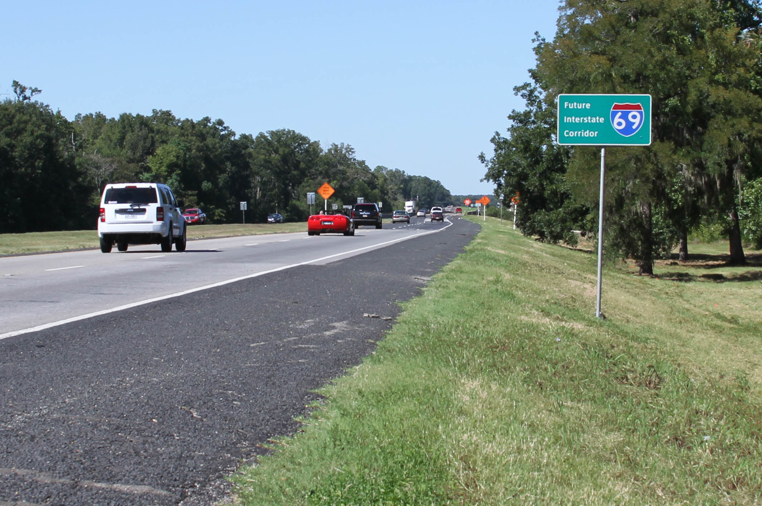
Supporting Progress on I-69 in Texas
www.i69TexasAlliance.com
Alliance for I-69 Texas
Notes:
I am proud to say we are making progress daily in Texas. We have momentum.
We have leadership on the Transportation Commission and at every level of TxDOT ‘s staff that is committed to I-69.
We have strong support from local communities that recognize the need for and benefits of I-69.
We have officials both in Washington and Austin that are actively working to support I-69.
I hope you will join us in 2015 to keep the progress going on 2015!

